Slide 2
The External Economic Action of the European Union and the Sustainable Development Goals
Filippo Fontanelli – University of Edinburgh – filippo.fontanelli@ed.ac.uk
University of Bologna
3 May – 25 May
12 May 2023
Energy and Trade

Slide 3
Outline of the module (in progress)
The course’s basic coordinates
  Trade law, investment law and sustainable development: basic notions
  EU competences and policies in trade and investment law
Trade/investment obligations and non-trade values: the return of unilateralism
  The backlash against investor-State arbitration.
  The backlash against trade liberalisation
  Reform proposals for the global investment and trade regimes
  An overview of re-nationalisation trends in trade an investment (US, EU, UK, China)
    Anti-coercion
    Anti-circumvention
    Retaliate against non-MPIA
    Steel row, now sustainable
EU’s external economic action to raise standards abroad
  Free trade agreements and non-economic standards
    Conflict mineral regulation (sort of like diamonds)
    2022 commitment to green trade partnership
    Deforestation MERCOSUR
  Zoom-in: EU dispute with Korea on labour rights
  Zoom-in: level playing field and sustainable development in the Trade and Cooperation Agreement between the EU and the UK
    Mirror clauses
The Carbon Border Adjustment Mechanism
  Overview and assessment of the scheme
  Compatibility with WTO law (China’s complaint at WTO)
  Bonus: carbon removal
Energy (trade)
  EU Net Zero Industry Act and support to renewable energy industry (with assessment of WTO compatibility)
  Reaction to comparable foreign plans (US IRA)
  Zoom-in: biofuels and e-fuels
Energy (investments)
  Foreign investment protection and the fossil fuels industry
  Foreign investment protection and the nuclear energy industry
  Foreign investment protection and the renewable energy industry
  The Energy Charter Treaty, its reform attempts and the withdrawal of EU MS
Controlling trade and investment inbound and outbound flows
  Export restrictions and export controls (including coordinated action with US)
  Critical Raw Materials Act
  EU investment screening
Improving supply chains’ sustainability
  Friend-shoring and sustainable value chains
  Global supply chain due diligence proposal
  EU Guidance to Combat Forced Labor in Supply Chains
  Responsible forestry proposal (trade in forest-risk commodities)
  WTO law-compatibility of these schemes
Promotion of other social interests
  Non-paper of the Commission services 2017 TSD chatpers
  Gender balance in corporate governance in FTAs
  Protection of indigenous peoples’ rights
UNA Europa presentation

Slide 4

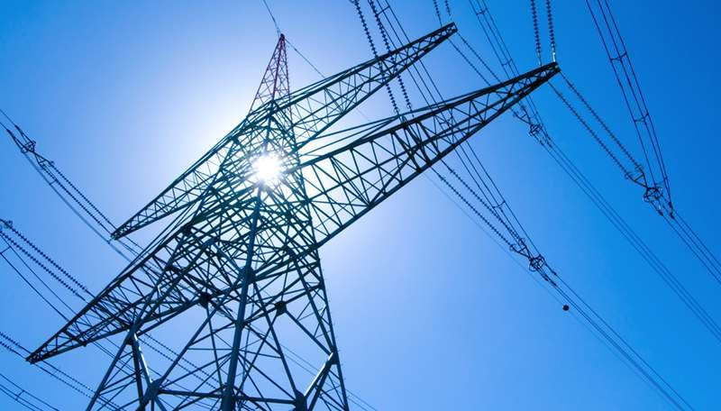
Energy package
Trade disputes regarding renewable energy products
The Inflation Reduction Act (IRA)
The Net Zero Industry Act
UNA Europa presentation

Slide 5
IRA and Green Deal what is going on?
UNA Europa presentation

Slide 6


Slide 7
Intermission: ROOs and LCRs
Origin of component/process warrants preferential advantage

Slide 8
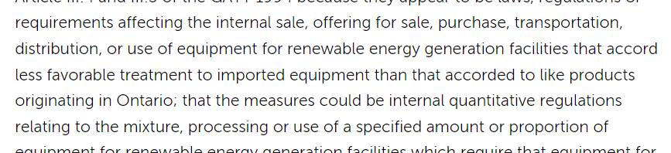
Business as usual at the WTO until the 2010s
DS412: Canada — Certain Measures Affecting the Renewable Energy Generation Sector
UNA Europa presentation

Slide 9
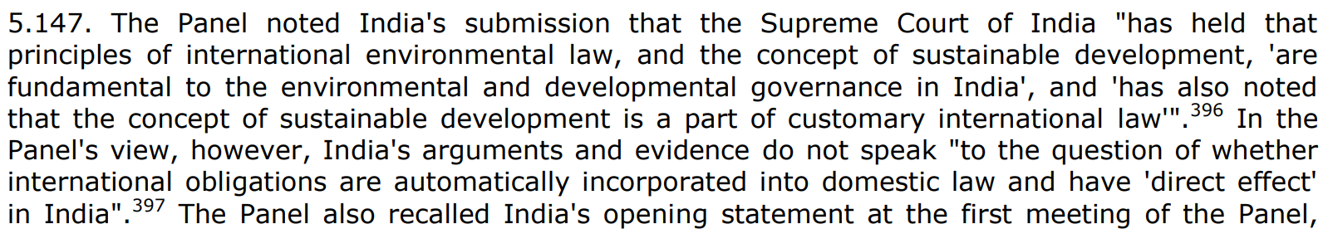
Business as usual at the WTO until the 2010s
456: India — Certain Measures Relating to Solar Cells and Solar Modules
UNA Europa presentation

Slide 10
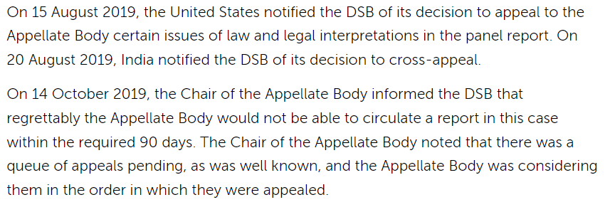
Business as usual at the WTO until the 2010s
DS510: United States — Certain Measures Related to Renewable Energy
UNA Europa presentation

Slide 11
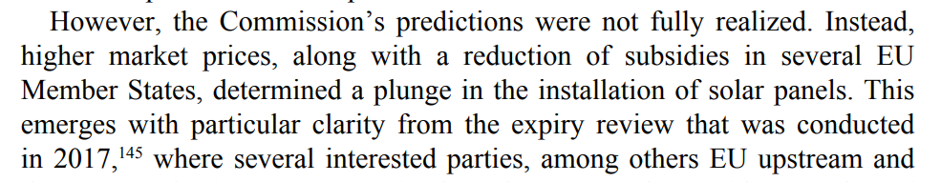

Trade remedies against energy goods
From Monti (Elgar, 2023) Promoting Renewable Energy
UNA Europa presentation

Slide 12
Continue with duties?
This analysis showed that the EU industry had not benefitted from the decreasing market share of Chinese imports resulting from the measures, but lost a further market share to increasing imports from South-Asian countries in particular.
In this case, a balance had to be found between the interests of EU producers of solar cells and panels, users and importers. The Commission strived to ensure that consumers could buy panels at prices close to world-market level. In March 2017, after consulting the Member States, the Commission decided that an 18-month extension of anti-dumping and anti-subsidy measures (‘the measures’) constituted the right balance between the various interests.
In its analysis which led to the decision not to further extend the measures beyond the agreed 18 months, the Commission considered the Union's new 2030 targets for renewable energy as well as the interest of users (installation companies and consumers) to have access to solar cells and panels at competitive prices. In these circumstances, keeping the measures in place could have become a barrier to the increase of demand necessary to meet the Union's targets for renewable energy.
Moreover, the decrease in solar panel component costs was a factor taken into account. The production costs of solar cells and modules have dropped significantly in the course of recent years and continued since March 2017, albeit at a somewhat slower pace.
UNA Europa presentation

Slide 13
Trade remedies against energy goods
UNA Europa presentation

Slide 14
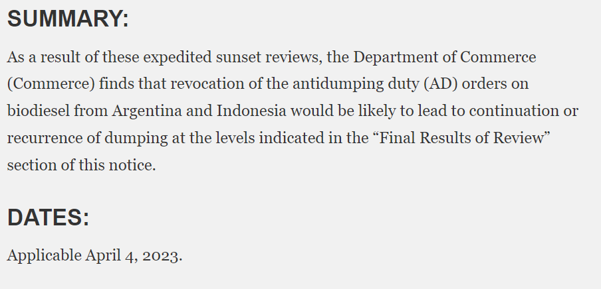
Trade remedies against energy goods
UNA Europa presentation

Slide 15
US remedies against renewable energy goods
2011-2012
Full range: against solar and wind energy components
Safeguards, AD duties and countervailing measures
https://sustainability.freshfields.com/post/102ie95/esg-considerations-in-trade-remedies-the-past-present-and-future
Countervailing: retaliation for 600mln$+
Other cases pending/not concluded
UNA Europa presentation

Slide 16

Energy packages
Japan’s Green Transformation programme
Indian Production Linked Incentive scheme
US’ Inflation Reduction Act (IRA)
EU’s Net Zero Industry
UNA Europa presentation

Slide 17
IRA
High tax credit for electric cars, based on origin of components (raw materials and batteries) and location of assembly
UNA Europa presentation

Slide 18

Goals of IRA?
Transition to green economy is the priority
Through:
Decoupling from China (sustainable supply chains)
Reshoring/friendshoring green industry (LCR)
  https://www.nytimes.com/2022/11/18/business/friendshoring-jargon-business.html

Slide 19
Critical mineral requirement
UNA Europa presentation

Slide 20
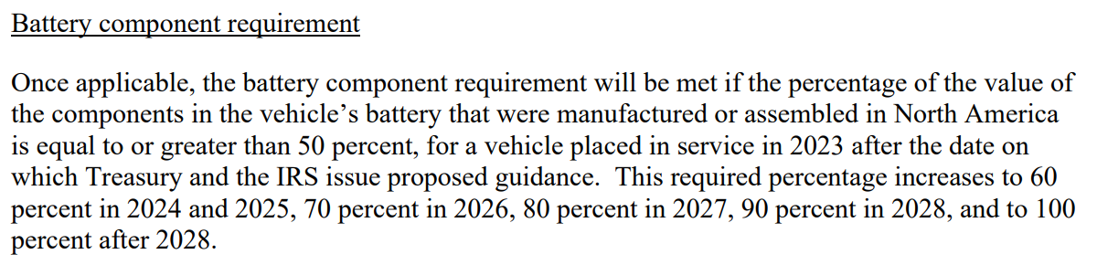
Battery component requirement
UNA Europa presentation

Slide 21
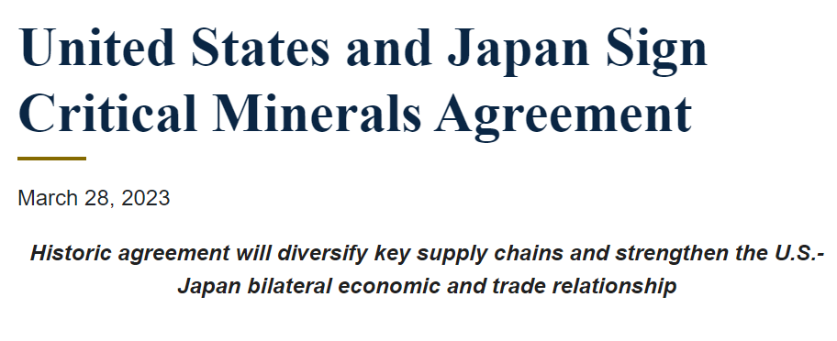
Free trade agreements?
UNA Europa presentation

Slide 22
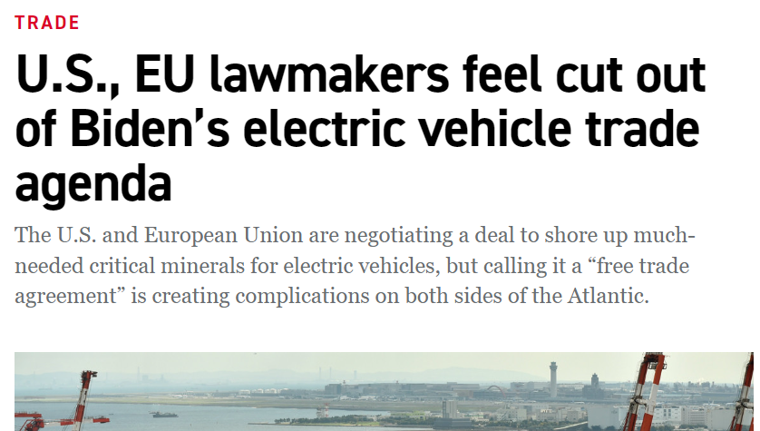
What about the EU?
UNA Europa presentation

Slide 23
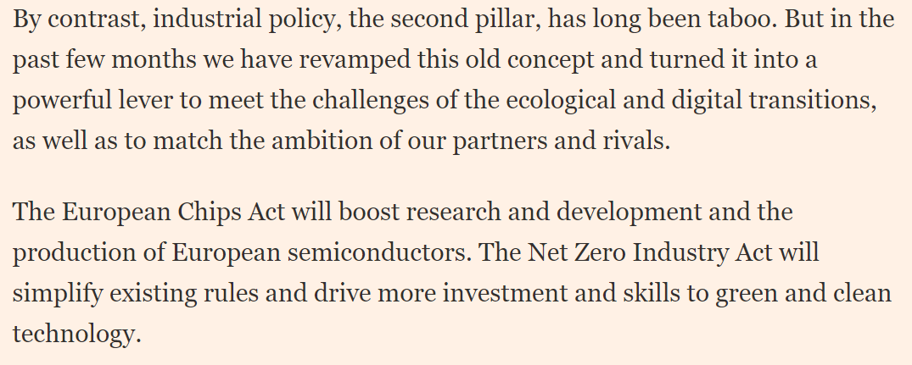
Net Zero
UNA Europa presentation

Slide 24
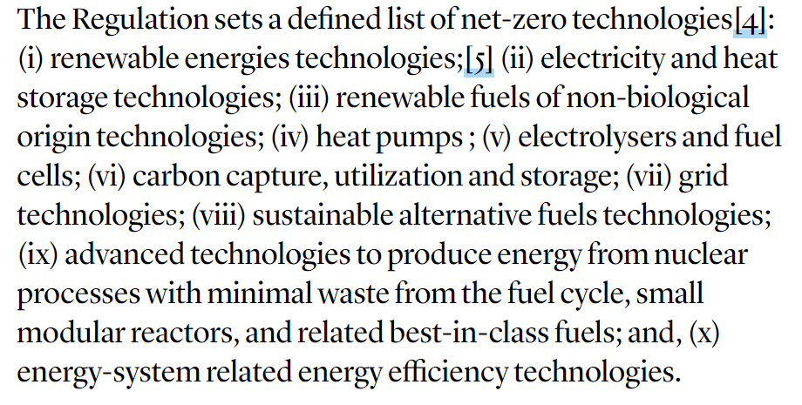
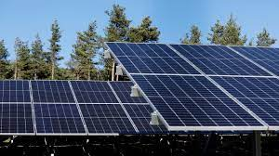
Net Zero
UNA Europa presentation

Slide 25

Local Content Requirements
Both IRA and EU plan include LCRs.
Risk: best technologies lose out to local technologies.
Immediate result: local companies consider relocating where the benefits are granted.
UNA Europa presentation

Slide 26
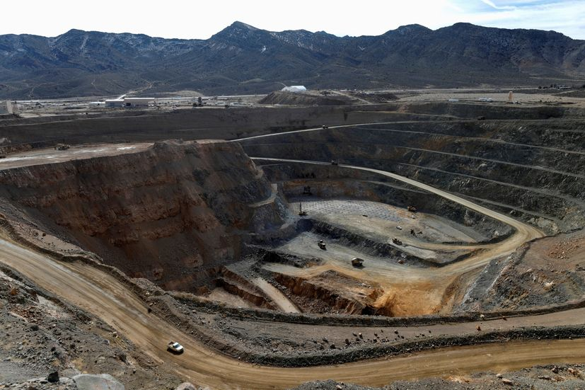
Run for raw materials
Risk of weaponising raw materials (like energy in 2022)
Big reserves in Africa (outside China)
UNA Europa presentation

Slide 27
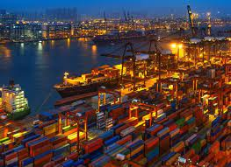
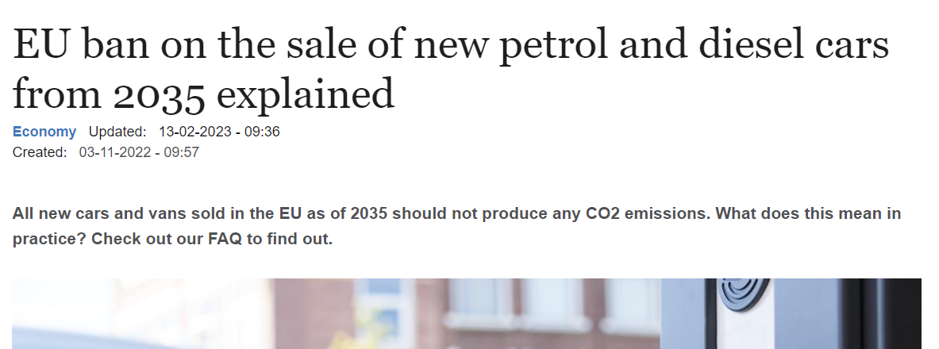
New rules on car emissions
UNA Europa presentation

Slide 28
Any exception?
UNA Europa presentation

Slide 29
@una_europa
#Una_Europa
Thanks!

